Slide 1
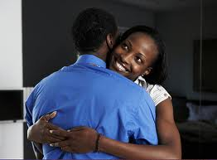
CREATING HEALTHY RELATIONSHIPS
Notes:
Humans throughout our existence have been communal. That is how we survive. Even though we can ostensibly live by ourselves, the facts remain…
We don’t want to be alone
We can’t survive without society
We need laws and boundaries to be safe
We thrive in loving and caring environments

Slide 2
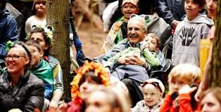
The importance of good relationships
1. Happiness, less conflict
2. Emotional wellness
3. Physical well being
4. Safety net
5. Financial improvement
6. Personal satisfaction
Notes:
Arguably the most important survival training we have as humans is how to get along with each other
But there is no handbook, no schooling, no specific training course that gives us these skills
Instead, we are left to learn from trial and error, often repeating the same mistakes our parents and acquaintances made because we have no good reference or model.
Here we have distilled the research and learning of many secular and spiritual advisors to give you a starter course on how to develop healthy personal relationships.

Slide 3
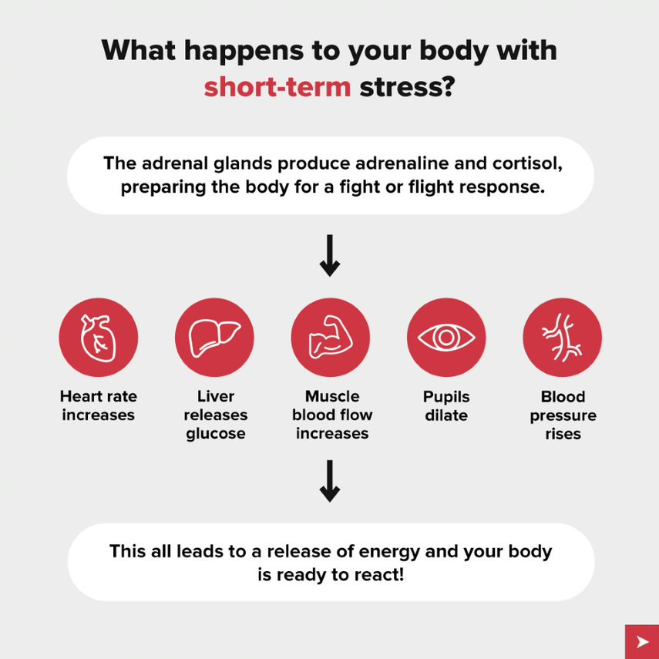
Stress is your body’s natural reaction to danger
Notes:
Our bodies are amazingly adaptable to the environment. We can sense danger quickly and our whole system rapidly alters to deal with a threat. This is a marvelous survival capability. In the short term, this saves our lives.

Slide 4
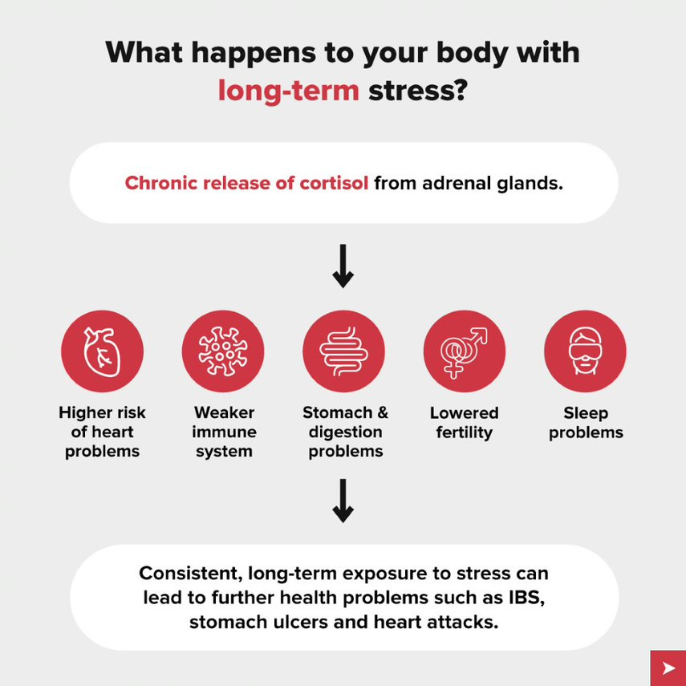
Chronic stress results in long-term drain on the body.
Notes:
But when we have repeated, prolonged exposure to supposed danger, in the form of adverse conditions, insecurity, rejection, criticism, threats, uncertainty, our bodies cannot cope with the constant flush of chemicals that keeps us on high alert. It takes a dangerous toll.
What relational experiences might make someone over stressed?

Slide 5
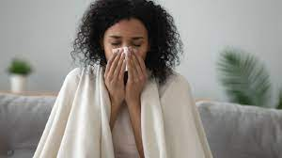
Negative physical effects of relational stress
Prolonged stress contributes to
1. High blood pressure
2. Heart disease
3. Impaired immune system
4. Diabetes
5. Depression
6. Stomach and gut pain
7. Inflammation
Notes:
These reactions have been well documented.
Being in an unhappy relationship can literally make you sick.

Slide 6
Start working toward change
Think about a specific relationship that is not positive
Spouse, family, friend, neighbor, co-worker
Identify your feelings about this person
Sad, regretful, angry, fearful, bored, worried, disappointed
Notes:
Example- Our neighbors had a very aggressive dog. It was usually restrained behind a wire fence, but she would still growl and bark menacingly every time we went outside. One day the dog was out and attacked me when I went to get the mail. Afterward I got stomach cramps and rapid breathing even thinking about getting the mail. I freeze and cower when I come near any dog now.
Sometimes our feelings about people can be that strong and frightening.
Say, for example you feel uneasy when you are with your father-in-law.
What happens to set you on edge?
Do you feel judged?
Do you feel compared with others?
Are you anxious to please?
Do you have to bite your tongue in response to him?
Do you feel it is hard work to have a conversation?

Slide 7
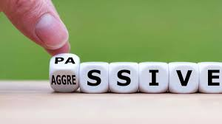
Passive, unproductive behaviors
Complaining
Wishing
Scheming
Hoping
Ignoring
Enduring
Notes:
What are your methods of dealing with uncomfortable people?
How do you react to loud boorish people?
What do you do when you are around someone shy?
What is your behavior with moody teenagers?
Describe your method of dealing with someone who talks too much.
How do you treat people who are bossy?

Slide 8
What YOU can DO
Take a hard look at yourself
Identify what you are doing to contribute to the problem
Can you see a pattern in relational troubles?
Being disrespected
Feeling angry
Over pleasing, giving more than you get
Criticism of others, they need to change
Not feeling loved
Notes:
Many relational conflicts leave us confused and feeling powerless. It is helpful to have some steps to follow to work through our emotions, label them and look at them more objectively. Seeing how and why we are hurting will help us move towards greater understanding of ourselves and others.

Slide 9
Relationships are vitally important to our health and well being
This course will help you
1. Realize you have no power to change anyone but yourself
2. Learn self control methods
3. Reach out with love and assertive confidence
Notes:
What do you hope to get from this course?
Do you have specific questions or experiences you would like addressed?

